Slide 1
Why we should use
Restful/Web API ?

Slide 2

RESTFUL/WEB API
Restful/Web API or web service ?
What are the best practice ?
What it's look like ?
Why the documentation is important ?
What about the security ?

Slide 3
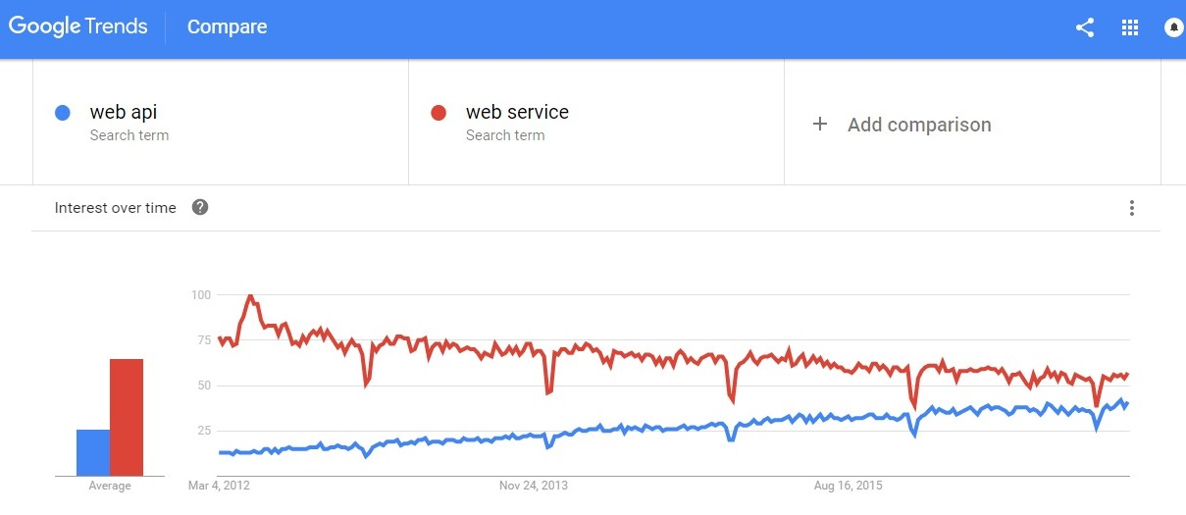
Comparing current trending

Slide 4
Restful API vs Web Service
Web Service | Web/Restful API
Web Service is heavy-weight XML | Response can be XML or Json
Web Service have very strict rule | Restful doesn't need strict API definition
Web service Result can be HTML and not only the data but also containing the HTML format for the data | Result of the restful API is only the data you need

Slide 5

WHAT IS API ? RESTFUL API ?
Application program interface (API) is a set of routines, protocols, and tools for building software applications

Slide 6
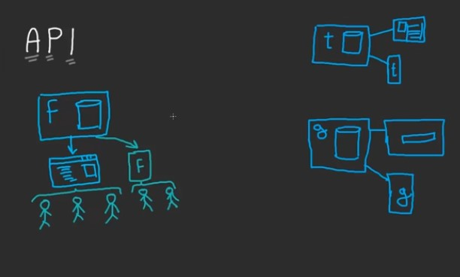
WHY RESTFUL/WEB API
More standardized (less duplication)
More human readable (naming, format, modelisation approach)
RESTful services are much simpler to consume than SOAP based (regular) services. (better integration)
Multidevice (mobile/web/application)
Json performance (better than SOAP)

Slide 7
Benefits of API
Efficiency
Automation
Easy to integrate with other Apps
Multiple platform (Mobile, Web, Computer Application)

Slide 8
Important of the Best Practice for API
Use nouns but no verbs
GET method and query parameters should not alter the state
Use plural nouns
Use sub-resources for relations
Provide filtering, sorting, field selection and paging for collections
Versioning
Handle your Errors with HTTP status codes

Slide 9
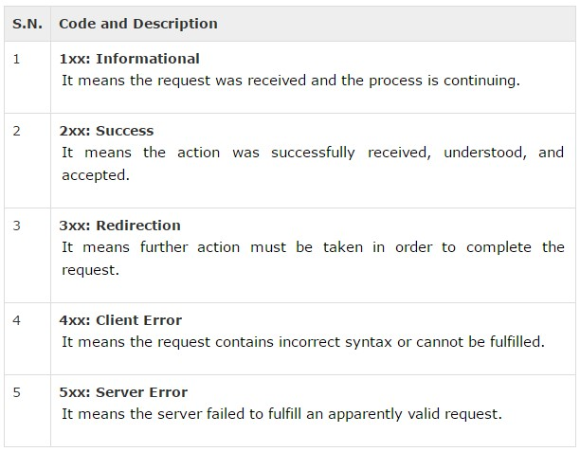
HTTP Status Code

Slide 10
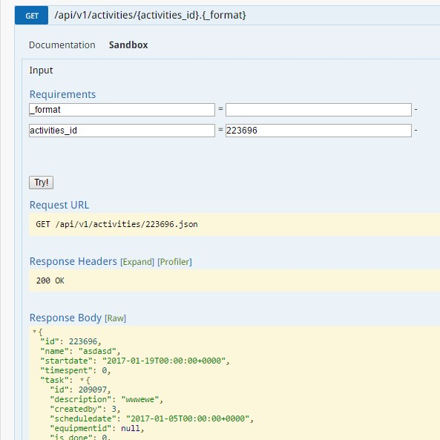
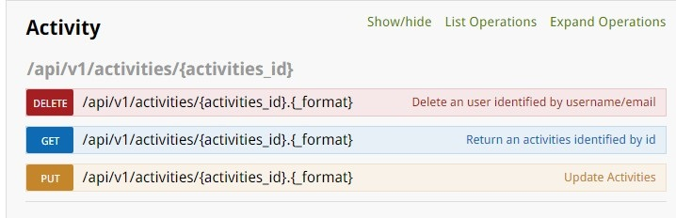
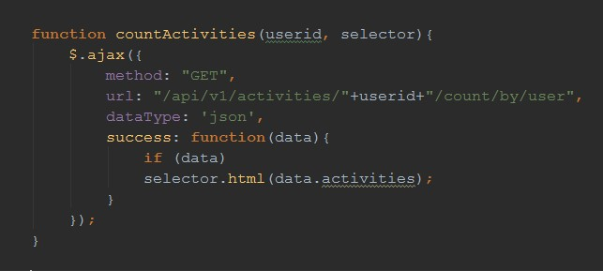
How easy to use Restful API

Slide 11
Documentation of Restful API
The purpose of documentation (Enhance developer)
Auto generated documentation (Sphinx, Swagger,
Stoplight, Spring REST Docs, ApiDocJS)
The type of documentation :
Resource descriptions
Endpoint definitions and methods
Parameters
Sample requests
Sample responses
Error codes
Code samples

Slide 12
How we are going to secure it ?
OAuth
Basic authentication
Session
Hashed ID/Token

Slide 13


Slide 14
Q & A

